Slide 1
B. Elan Dresher
Foundations of Contrastive
Hierarchy Theory

Slide 2
Monday 26 October 2020
Introduction
Part I:
Historical Antecedents
Part II:
A Theory of Contrast
Conclusion
Introduction

Slide 3
Introduction
In this talk I will present a brief introduction to a theory of contrastive feature hierarchies in phonology.
I start from the assumption that phonology is about contrast; without contrast, there is no phonology, only phonetics or the physics of speech (Dresher & van der Hulst to appear).
The question, which Contrastive Hierarchy Theory addresses, is how contrast should be incorporated into phonological theory.
Contrastive Hierarchy Theory is built on essentially two ideas:
3

Slide 4
Introduction
The first idea is that phonological primes (in my case, binary features) are computed hierarchically, with the choice and ordering of the primes being language particular.
The second hypothesis is that only contrastive primes are computed by the phonology; non-contrastive features can be added, for example by enhancement, in a post-phonological component.
I will show how the theory has been applied to vowel reduction in Brazilian Portuguese and the acquisition of its vowel system.
I will then show how the West Germanic vowel system provides a challenging empirical test of the theory (spoiler alert: the theory will pass the test!).
4

Slide 5
Introduction
Before getting to that, in the first part of the talk I will show that the central ideas of Contrastive Hierarchy Theory, in one form or another, have been hiding in plain sight at the centre of the history of phonology.
I will begin with Henry Sweet, at the dawn of modern phonology.
Most directly, the theory adapts proposals by Roman Jakobson and N. S. Trubetzkoy to the generative framework of Noam Chomsky and Morris Halle.
5

Slide 6
Monday 26 October 2020
Introduction
Part I:
Historical Antecedents
Part II:
A Theory of Contrast
Conclusion
The structure and progress of this talk is indicated in the panel:
you are here
6

Slide 7
Monday 26 October 2020
Introduction
Part I
1. Sweet
2. Trubetzkoy
3. Jakobson
4. Halle
5. Chomsky & Halle
Part II
Conclusions
Part I: Historical Antecedents
1. Sweet 1877
Contrastive Properties and
‘Broad Romic’ Transcription

Slide 8
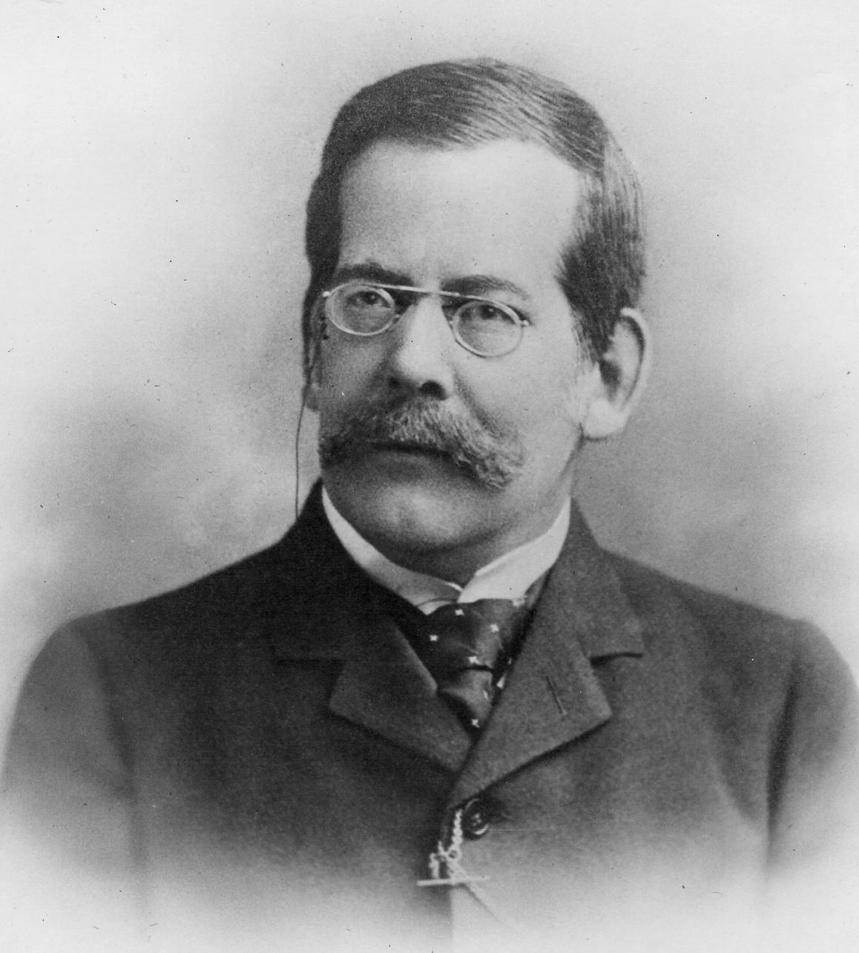
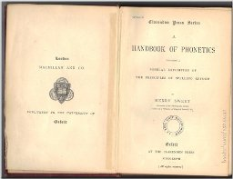
Contrast and Broad Transcription
According to Daniel Jones (1967: 256), Henry Sweet (1845–1912) was the first to distinguish a detailed phonetic transcription (what he called ‘Narrow Romic’) from a phonemic transcription suitable to an individual language (‘Broad Romic’).
8

Slide 9
Contrast and Broad Transcription
For example, the vowels in the English words bait and bet differ in three ways: the vowel in bait is longer and tenser than in bet, and is a diphthong, whereas the vowel in bet is a monophthong.
An accurate phonetic transcription would indicate all these distinctions; in the current notation of the International Phonetic Alphabet (IPA), they are transcribed as shown.
Differences
IPA
bait
long, tense, +j
[eːj]
bet
short, lax, +Ø
[ɛ]

Slide 10
Contrast and Broad Transcription
These three differences, however, are not independent: recombining the various properties to create new vowels as shown would not result in a new word distinct from both bait and bet, but would be heard as some (perhaps odd-sounding) variant of one of these words.
Sweet (1877: 104) writes: “we may lay down as a general rule that only those distinctions of sounds require to be symbolized in any one language which are independently significant.”
Differences
IPA
Non-contrasting vowels
bait
long, tense, +j
[eːj]
[eː], [ej], [e], [ɛː], [ɛj], [ɛːj]
bet
short, lax, +Ø
[ɛ]

Slide 11
Contrast and Broad Transcription
Further, “if two criteria of significance are inseparably associated, such as quantity and narrowness or wideness [i.e., tenseness or laxness/BED], we only need indicate one of them.”
Sweet proposes (1877: 109–110) that in broad transcription [eːj] should be transcribed ‘ei’ (or, equivalently, ‘ej’) and [ɛ] as ‘e’.
Thus, of the three differences in the vowels, he chooses the presence of an off-glide j as significant, ignoring both quantity (length) and narrowness or wideness (tenseness or laxness).
Differences
IPA
Broad
bait
long, tense, +j
[eːj]
ei or ej
bet
short, lax, +Ø
[ɛ]
e

Slide 12
Contrast and Broad Transcription
In this case he gives the rationale for his choice. He observes (p. 110): “The narrowness of all [English] vowels is uncertain”, especially /ij/ and /ej/.
That is, vowels can vary in the degree to which they are tense or lax without essentially changing the identity of the vowel, as long as other properties do not change.
Narrowness
not contrastive
Differences
IPA
Broad
bait
long, tense, +j
[eːj]
ei or ej
[e:j] or [ɛ:j]
bet
short, lax, +Ø
[ɛ]
e
[ɛ] or [e]

Slide 13
Contrast and Broad Transcription
Similarly, he finds (p. 18) that “originally short vowels can be lengthened and yet kept quite distinct from the original longs.”
That is, [bɛt] (bet) can be lengthened to [bɛːt] without passing into bait, and [beːjt] (bait) can be shortened to [bejt] without being perceived as bet.
Length not
contrastive
Differences
IPA
Broad
bait
long, tense, +j
[eːj]
ei or ej
[e:j] or [ej]
bet
short, lax, +Ø
[ɛ]
e
[ɛ] or [ɛ:]

Slide 14
Contrast and Broad Transcription
While tenseness and length can be altered without changing one vowel phoneme into another one, presumably the same is not the case for the third distinguishing property.
Adding a glide to the vowel in bet, or removing it from bait, could cause the resulting vowel to be perceived as having changed category.
Glide is
contrastive
Differences
IPA
Broad
bait
long, tense, +j
[eːj]
ei or ej
[e:j] not [eː]
bet
short, lax, +Ø
[ɛ]
e
[ɛ] not [ɛj]

Slide 15
Contrast and Broad Transcription
We can conclude from his discussion that Sweet’s analysis posits that the contrastive properties of both the vowels in bait and bet are mid and front, with no contrastive specification for tenseness or quantity.
The difference in the two words resides in the addition of a second segment to the vowel in bait.
Contrastive
properties
Differences
IPA
Broad
bait
long, tense, +j
[eːj]
ei or ej
mid, front, off-glide j
bet
short, lax, +Ø
[ɛ]
e
mid, front

Slide 16
Contrast and Broad Transcription
Sweet did not propose a method for computing contrastive properties, nor did he consistently attempt to identify what the contrastive properties are for every segment (Dresher 2016).
However, we can see in his work the ideas that:
only contrastive properties need be transcribed,
and these properties can be identified by observing how sounds function in a language.
The further development of these ideas, and their connection with feature hierarchies, came some years later in the work of the Prague School linguists, notably N. S. Trubetzkoy (1890–1938) and Roman Jakobson (1896–1982).
16

Slide 17
Monday 26 October 2020
Introduction
Part I
1. Sweet
2. Trubetzkoy
3. Jakobson
4. Halle
5. Chomsky & Halle
Part II
Conclusions
Part I: Historical Antecedents
2. Trubetzkoy 1939
Phonemic Content and
Contrast as ‘Point of View’
17

Slide 18
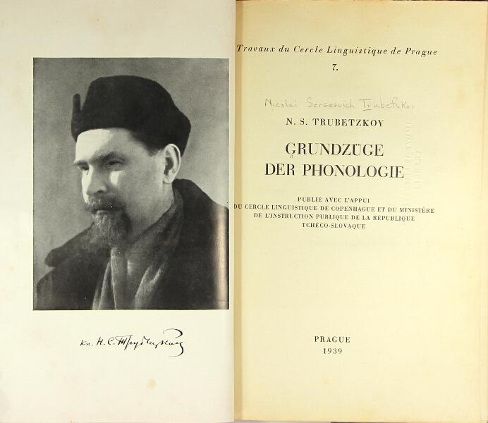
Trubetzkoy’s Grundzüge der Phonologie
N. S. Trubetzkoy’s Grundzüge der Phonologie (1939; English version 1969, new critical Spanish edition 2019) is notable for its insights into the nature of contrast.
Notes:
kínderʃpraxə, afazí, unt algəmáinə láwtgəzɛtsə

Slide 19
Phonemic content
An important notion of Trubetzkoy’s is phonemic content: “By phonemic content we understand all phonologically distinctive properties of a phoneme…” (Trubetzkoy 1969: 66).
“Each phoneme has a definable phonemic content only because the system of distinctive oppositions shows a definite order or structure.” (1969: 67–8)
“the content of a phoneme depends on what position this phoneme takes in the given phonemic system …” (1969: 67)

Slide 20
Phonemic content and structure of the system
“the system of distinctive oppositions shows a definite order or structure … the content of a phoneme depends on what position this phoneme takes in the given phonemic system …”
These remarks suggest that the phonemic content of a phoneme, that is, the set of its contrastive properties, ought to derive from its position in the system of distinctive oppositions.
Therefore, we need a way to determine a phoneme’s position in the system of oppositions before we have determined its distinctive properties.

Slide 21
Phonemic content and structure of the system
“the system of distinctive oppositions shows a definite order or structure … the content of a phoneme depends on what position this phoneme takes in the given phonemic system …”
Trubetzkoy does not explicitly show us how to do this; however, a way of providing an order or structure to the system of contrasts is via the hierarchical branching trees that became prominent later in the work of Jakobson.
Feature hierarchies are already implicit in Trubetzkoy (1939); consider his discussion of the Latin vowel system.

Slide 22
The vowel system of Latin
Trubetzkoy observes that in Latin, as in many five-vowel systems, the low vowel does not participate in tonality contrasts; ‘tonality’ refers to backness or lip rounding, that is, properties that affect the second formant (F2).
That is, the low vowel /a/ is characterized only by its height; in our terms, it is assigned only the feature [+low].
Latin
/i/
/u/
But how can we prevent /a/ from receiving other features?
[–low]
/e/
/o/
We can if we assign contrastive features in an order, in a feature hierarchy.
[+low]
/a/

Slide 23
The vowel system of Latin
In order to exclude /a/ from receiving tonality features, it is necessary to order [±low] at the top of the feature hierarchy: this has the effect of separating /a/ from the other vowels.
Since /a/ is already uniquely distinguished, it will receive no further features.
Latin
Top of the hierarchy: [low]
/i/
/u/
[+low]
[–low]
[–low]
/a/
/e/
/o/
[+low]
/a/

Slide 24
The vowel system of Latin
What the other two (or, more unusually, three) features are depends on the evidence from the language.
Common five-vowel systems use the features [±back] or [±round] and [±high].
Top of the hierarchy: [low]
[+low]
[–low]
/a/
[–back/round]
[+back/round]
[+high]
24
[–high]
[–high]
[+high]
/e/
/i/
/o/
/u/

Slide 25
Polabian: “A certain hierarchy”
The notion of a feature hierarchy is only implicit in Trubetzkoy’s discussion of the Latin vowel system.
Invoking a feature hierarchy is a way to make sense of his analysis.
In the case of Polabian, however, Trubetzkoy explicitly refers to a hierarchy.
He observes (1969: 102–3; 2019: 156) that “a certain hierarchy existed” in the vowel system of Polabian, whereby the contrast between front and back vowels is higher than the contrast between rounded and unrounded vowels.

Slide 26
Contrast depends on point of view
Another important insight is contained in a 1936 article addressed to psychologists and philosophers (Trubetzkoy 2001 [1936]: 20):
The correct classification of an opposition “depends on one’s point of view”; but “it is neither subjective nor arbitrary, for the point of view is implied by the system.”
What does this mean? To say that the correct classification depends on one’s point of view means that phonological contrasts can vary from language to language, and cannot be determined simply by inspecting an inventory.

Slide 27
‘Point of view’ means contrast is variable
We have seen that in Latin the low vowel /a/ is set apart from the other vowels, in Trubetzkoy’s analysis.
But this is not the only way to draw the contrasts in a five-vowel system.
Latin
/i/
/u/
[–low]
/e/
/o/
[+low]
/a/

Slide 28
‘Point of view’ means contrast is variable
It is possible, for example, to group the low vowel /a/ with the other [–round] vowels.
Troubetzkoy proposes that Archi (East Caucasian, in Central Daghestan) has a vowel system that is divided in this manner.
Archi
[–round]
[+round]
/i/
/u/
/e/
/o/
He says this because of the way the sounds behave.
/a/

Slide 29
‘Point of view’ means contrast is variable
Trubetzkoy observes that a consonantal rounding contrast is neutralized before and after the rounded vowels /u/ and /o/, contrasting these vowels with unrounded /i/, /e/, and /a/.
Archi
[–round]
[+round]
/i/
/u/
“This means that all vowels are divided into rounded and unrounded vowels, while the back or front position of the tongue proves irrelevant…” (Trubetzkoy 1969: 100–1).
/e/
/o/
/a/

Slide 30
‘Point of view’ means contrast is variable
This analysis corresponds to ordering [±round] first, dividing the vowels into two groups: /i, e, a/ and /u, o/.
Further distinctions within these groups are made by other features; the tree below shows one possible feature hierarchy.
Archi
[round] > [high] > [low]
[–round]
[+round]
/i/
/u/
[–round]
[+round]
/e/
/o/
[+high]
[–high]
[+high]
[–high]
/i/
/u/
/o/
/a/
[–low]
[+low]
/e/
/a/

Slide 31
Five-vowel systems: Japanese
In Japanese, Trubetzkoy argues that neutralization of the opposition between palatalized and non-palatalized consonants before /i/ and /e/ shows that these vowels are put into opposition with the other vowels /a, o, u/.
Japanese
[+front]
[–front]
/i/
/u/
The governing opposition is that between front and back vowels, “lip rounding being irrelevant” (Trubetzkoy 1969: 101).
/e/
/o/
/a/

Slide 32
Five-vowel systems: Japanese
This analysis corresponds to ordering [front] first.
The rest of the tree is adapted from Hirayama (2003).
These feature trees are implicit in Trubetzkoy, but they become explicit in the work of Roman Jakobson and his collaborators.
Japanese
[front] > [open] > [low]
[+front]
[–front]
/i/
/u/
[+front]
[–front]
/e/
/o/
[+open]
[–open]
[+open]
[–open]
/e/
/i/
/u/
/a/
[+low]
[–low]
/a/
/o/

Slide 33
Monday 26 October 2020
Introduction
Part I
1. Sweet
2. Trubetzkoy
3. Jakobson
4. Halle
5. Chomsky & Halle
Part II
Conclusions
Part I: Historical Antecedents
3. Jakobson 1941
The Acquisition of
Phonological Contrasts
33

Slide 34
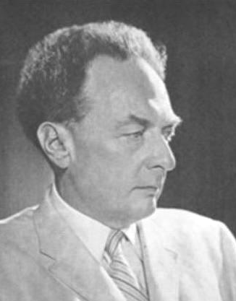
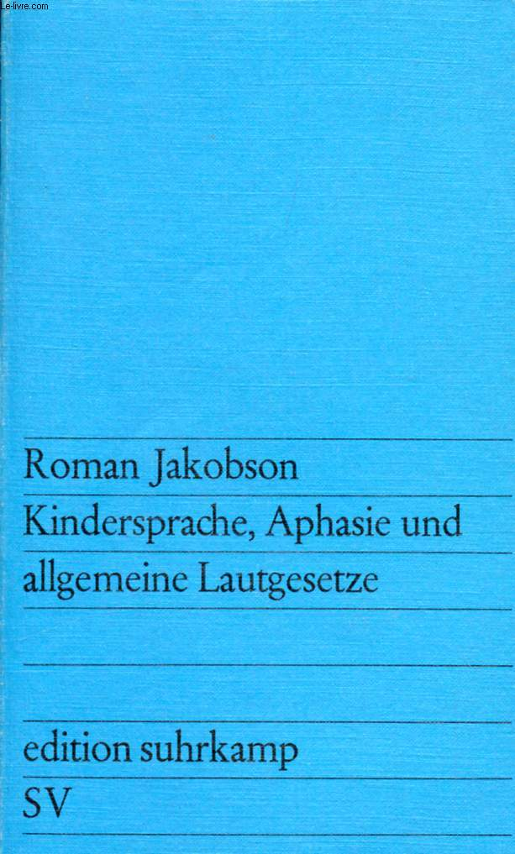
Jakobson’s Kindersprache
Jakobson’s Kindersprache (1941; English trans. 1968, Spanish 1974), advances the notion that contrasts are crucial in phonological acquisition and that they develop in a hierarchical order.
In particular, he proposes that learners begin with broad contrasts that are split by stages into progressively finer ones.
Notes:
kínderʃpraxə, afazí, unt algəmáinə láwtgəzɛtsə

Slide 35
Acquisition sequences (vowels)
vowel
/V/
The acquisition of vowel systems set out in Jakobson (1941) and Jakobson & Halle (1956) follows this schema.
At the first stage, there is only a single vowel. As there are no contrasts, we can simply designate it /V/.

Slide 36
Acquisition sequences (vowels)
vowel
/V/
[a]
Jakobson & Halle write that this lone vowel is the maximally open vowel [a], the ‘optimal vowel’.
But we don’t need to be that specific: we can understand this to be a default value, or a typical but not obligatory instantiation.
36

Slide 37
Acquisition sequences (vowels)
vowel
narrow
/V/
wide
/I/
/A/
In the next stage it is proposed that the single vowel splits into a narrow (high) vowel /I/, which is typically [i], and a wide (low) vowel, /A/, typically [a].
I will continue to understand these values as defaults.

Slide 38
Acquisition sequences (vowels)
vowel
narrow
wide
palatal
/I/
velar
/A/
/I/
/U/
In the next stage the narrow vowel splits into a palatal (front) vowel /I/ and a velar (back or round) vowel /U/, typically [u].
38

Slide 39
Acquisition sequences (vowels)
vowel
narrow
wide
palatal
velar
palatal
/A/
velar
/I/
/U/
/æ/
/a/
After the first two stages, Jakobson & Halle allow variation in the order of acquisition of vowel contrasts.
The wide branch can be expanded to parallel the narrow one.

Slide 40
Acquisition sequences (vowels)
vowel
narrow
wide
palatal
velar
/a/
unrnd
rnd
unrnd
rnd
/i/
/y/
/ɨ/
/u/
Or the narrow vowels can develop a rounding contrast in one or both branches.

Slide 41
Contrastive features assigned hierarchically
Continuing in this fashion we will arrive at a complete inventory of the phonemes in a language, with each phoneme assigned a set of contrastive properties that distinguish it from every other one.
This approach has two notable characteristics:
Only contrastive features are assigned to each phoneme.
Contrastive features are assigned hierarchically, in a way that can be represented by a branching tree.

Slide 42
Monday 26 October 2020
Introduction
Part I
1. Sweet
2. Trubetzkoy
3. Jakobson
4. Halle
5. Chomsky & Halle
Part II
Conclusions
Part I: Historical Antecedents
4. Halle 1959
An argument for specification
by branching trees

Slide 43
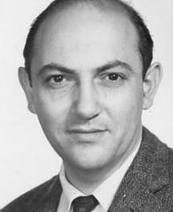
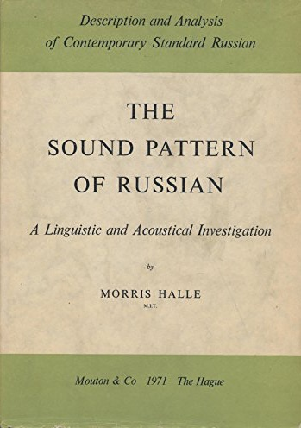
An argument for branching trees
In The Sound Pattern of Russian (1959; SPR), Halle makes an argument on behalf of branching trees; this is the first such argument I have found in the literature.

Slide 44
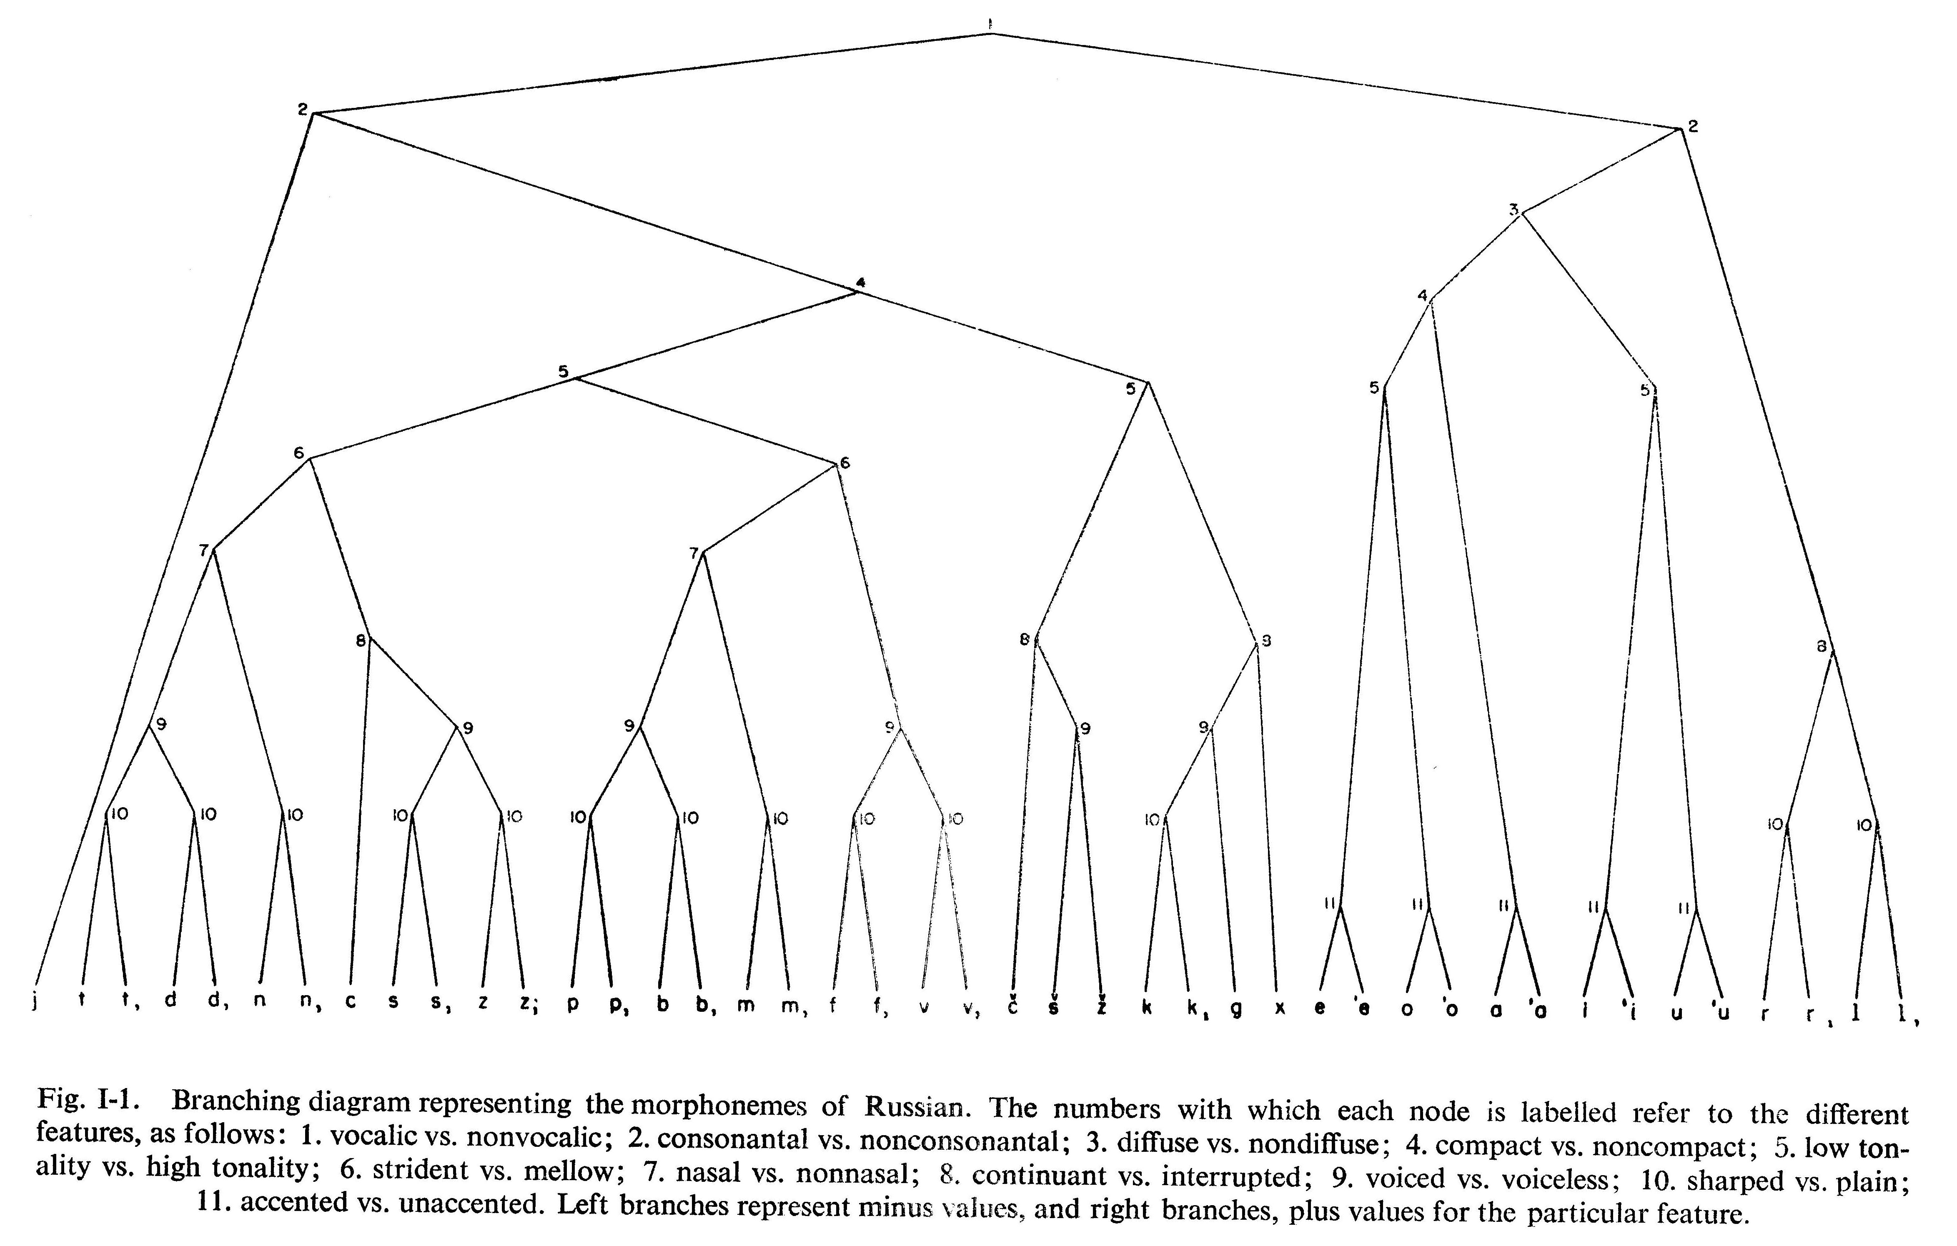
He argues that feature specification by a branching tree is the only way to ensure that segments are kept properly distinct.
Figure I-1 in The Sound Pattern of Russian, p. 46
(This is his tree
for Russian.)
44

Slide 45
The Distinctness Condition
Specifically, Halle proposed (1959: 32) that phonemes must meet the Distinctness Condition:
The Distinctness Condition
Segment-type /A/ will be said to be different from segment-type /B/, if and only if at least one feature which is phonemic in both, has a different value in /A/ than in /B/; i.e., plus in the former and minus in the latter, or vice versa.
This formulation is designed to disallow contrasts involving a zero value of a feature.
45

Slide 46
How do we establish contrasts?
Consider the typical sub-inventory /p, b, m/ shown below, and suppose we characterize it in terms of two binary features, [±voiced] and [±nasal].
In terms of full specifications, /p/ is [–voiced, –nasal], /b/ is [+voiced, –nasal], and /m/ is [+voiced, +nasal].
Which of these features is contrastive? Many people reason as follows:
/p/
/b/
/m/
[voiced]
–
+
+
[nasal]
–
–
+

Slide 47
How do we establish contrasts?
We observe that/p/ and /b/ are distinguished only by [voiced]; so these specifications must be contrastive.
Similarly, /b/ and /m/ are distinguished only by [nasal]; these specifications must also be contrastive.
What about the uncircled specifications? These are predictable from the circled ones:
/p/
/b/
/m/
[voiced]
–
+
+
[nasal]
–
–
+

Slide 48
How do we establish contrasts?
Since/p/ is the only [–voiced] phoneme in this inventory, its specification for [nasal] is predictable, hence redundant. We can write a rule or constraint:
Similarly, /m/ is the only [+nasal] phoneme, so its specification for [voiced] is redundant:
This is a still-popular way of thinking about contrastive specifications; we can call it the ‘Minimal Difference’ approach (e.g. Padgett 2003, Calabrese 2005, Campos-Astorkiza 2009, Nevins 2010).
/p/
/b/
/m/
[voiced]
–
+
+
If [–voiced], then [–nasal]
[nasal]
–
–
+
If [+nasal], then [+voiced]

Slide 49
How do we establish contrasts?
According to Minimal Difference, a feature is only contrastive in a segment if it is the only feature that distinguishes that segment from another one.
But according to the Distinctness Condition, /p/ is not ‘different from’ /m/: where one has a feature, the other has none.
Therefore, these specifications are not properly contrastive.
/p/
/b/
/m/
[voiced]
–
+
[nasal]
–
+

Slide 50
The Distinctness Condition
They violate the Distinctness Condition because no feature hierarchy yields this result.
If we order [voiced] > [nasal], we generate an ‘extra’ specification on /m/.
/p/
/b/
/m/
[–voiced]
[+voiced]
/p/
[voiced]
–
+
+
[–nasal]
[+nasal]
[nasal]
–
+
/b/
/m/

Slide 51
The Distinctness Condition
If we order [nasal] > [voiced], we generate an ‘extra’ specification on /p/.
/p/
/b/
/m/
[–nasal]
[+nasal]
/m/
[voiced]
–
+
[–voiced]
[+voiced]
[nasal]
–
–
+
/p/
/b/

Slide 52
Contrastive ≠ Unpredictable
Either of the specifications below is properly contrastive.
[voiced] > [nasal]
[nasal] > [voiced]
Note that in a hierarchical approach, a contrastive feature is not necessarily unpredictable.
[–voiced]
[+voiced]
[–nasal]
[+nasal]
/p/
/m/
[–nasal]
[+nasal]
[–voiced]
[+voiced]
/b/
/m/
/p/
/b/
/p/
/b/
/m/
/p/
/b/
/m/
[voiced]
–
+
+
–
+
[nasal]
–
+
–
–
+

Slide 53
Therefore, according to SPR, to ensure that all the phonemes of a language are distinct from one another, it is necessary that their feature specifications must be generable by a branching tree.
53

Slide 54
Contrast is hierarchical
I believe that Halle’s argument is correct: as demonstrated by Archangeli (1988) and in more detail by Dresher (2009), the Minimal Difference approach often fails to yield any intelligible set of specifications. It is the wrong theory of contrast.
Conceptually, the main flaw of Minimal Difference is its failure to recognize that contrastive relations in an inventory exist not just between pairs of segments, but also between groups of segments at different levels of the hierarchy.
Thus, there is a sense in which contrast is indeed minimal, almost by definition; but only when viewed in hierarchical layers, and not in pairwise comparisons.
54

Slide 55
Decline of the branching trees
It is ironic that while The Sound Pattern of Russian contains this original argument on behalf of branching trees, at the same time its analysis of Russian contributed to undermining the whole notion of contrastive specification (Dresher & Hall to appear).
Because of that, and due also to arguments by Lightner (1963) and Stanley (1967), underspecification was abandoned altogether in Chomsky & Halle’s The Sound Pattern of English (SPE, 1968), along with the branching trees (for reasons, see Dresher 2009: 96–104).
The result was that language-particular feature contrasts did not play a role in the theory of generative grammar that developed from SPE.
55

Slide 56
Monday 26 October 2020
Introduction
Part I
1. Sweet
2. Trubetzkoy
3. Jakobson
4. Halle
5. Chomsky & Halle
Part II
Conclusions
Part I: Historical Antecedents
5. Chomsky & Halle 1968
The Generative Framework
and Approach to Phonology
56

Slide 57
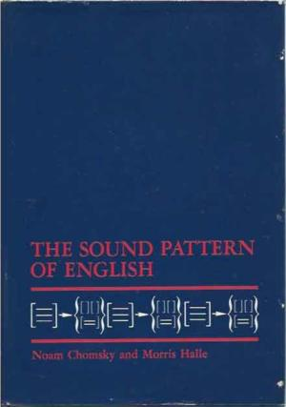
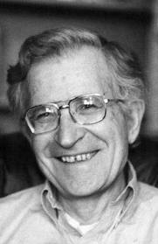
The generative framework
Though I depart from SPE with respect to contrast and the nature of features, Chomsky & Halle provide the broad generative framework and cognitive approach to phonology that I assume in the theory of contrast to which I now turn.
57

Slide 58
Monday 26 October 2020
Introduction
Part I
Part II
1. CHT Main Tenets
2. Features in CHT
3. Acquisition: BP
vowel system
4. Synchrony:
PGmc. Vowels
5. Diachrony: West
Gmc. i-Umlaut
Conclusions
Part II: A Theory of Contrast
Main Tenets of Contrastive
Hierarchy Theory (CHT)
58

Slide 59
Return of the branching trees
As a theory of phonological representations, branching trees were revived, under other names, by Clements (2001; 2003; 2009), and independently at the University of Toronto, where they are called contrastive feature hierarchies (Dresher, Piggott, & Rice 1994; Dyck 1995; Zhang 1996; Dresher 1998b; Dresher & Rice 2007; Hall 2007; Dresher 2009; Mackenzie 2009; etc.).
It is the latter approach I will be presenting here. It has gone under various names: Modified Contrastive Specification (MCS), or ‘Toronto School’ phonology, or Contrast and Enhancement Theory; I call it Contrastive Hierarchy Theory (CHT).
I don’t claim there is any ‘standard version’ of this theory; in what follows, I will present the theory as I understand it.
59

Slide 60
Contrast and hierarchy
The first major building block of our theory is that contrasts are computed hierarchically by ordered features that can be expressed as a branching tree.
Branching trees are generated by the Successive Division Algorithm (Dresher 1998b, 2003, 2009):
The Successive Division Algorithm
Assign contrastive features by successively dividing the inventory until every phoneme has been distinguished.
60

Slide 61
Criteria for ordering features
What are the criteria for selecting and ordering the features?
Phonetics is clearly important, in that the selected features must be consistent with the phonetic properties of the phonemes.
For example, a contrast between /i/ and /a/ would most likely involve a height feature like [low] or [high], though other choices are possible, e.g. [front] or [advanced/retracted tongue root].
/i/
/i/
[front]
[low]
/a/
/a/
61

Slide 62
Criteria for ordering features
Of course, the contrastive specification of a phoneme could sometimes deviate from the surface phonetics.
In some dialects of Inuktitut, for example, an underlying contrast between /i/ and /ə/ is neutralized at the surface, with both /i/ and /ə/ being realized as phonetic [i] (Compton & Dresher 2011).
In this case, /i/ and /ə/ would be distinguished by a contrastive feature, even though their surface phonetics are identical.
/i/
/u/
[front]
/ə/
[round]
[low]
/a/
62

Slide 63
Contrast and phonological activity
As the above example shows, the way a sound patterns can override its phonetics (Sapir 1925).
Thus, we consider as most fundamental that features should be selected and ordered so as to reflect the phonological activity in a language, where activity is defined as follows (adapted from Clements (2001: 77):
Phonological Activity
A feature can be said to be active if it plays a role in the phonological computation; that is, if it is required for the expression of phonological regularities in a language, including both static phonotactic patterns and patterns of alternation.
63

Slide 64
A theory of contrastive specification
The second major tenet has been formulated by Hall (2007) as the Contrastivist Hypothesis:
The Contrastivist Hypothesis
The phonological component of a language L operates only on those features which are necessary to distinguish the phonemes of L from one another.
That is, only contrastive features can be phonologically active. If this hypothesis is correct, it follows as a corollary that
Corollary to the Contrastivist Hypothesis
If a feature is phonologically active, then it must be contrastive.
64

Slide 65
Domain of the Contrastivist Hypothesis
On this hypothesis, underlying lexical representations consist only of contrastive specifications.
These representations form the input to the contrastive phonology, which is the domain in which the Contrastivist Hypothesis applies.
Underlying Lexical Representations
Contrastive features only
Phonology governed by the
Contrastivist Hypothesis
Output of Contrastive Phonology
65

Slide 66
Domain of the Contrastivist Hypothesis
Stevens, Keyser & Kawasaki (1986) propose that feature contrasts can be enhanced by other features with similar acoustic effects (see also Stevens & Keyser 1989; Keyser & Stevens 2001, 2006).
Our hypothesis is that enhancement takes place after the contrastive phonology, when further phonetic detail is specified.
Underlying Lexical Representations
Contrastive features only
Phonology governed by the
Contrastivist Hypothesis
Output of Contrastive Phonology
Phonetic processes: enhancement,
non-contrastive features
Surface Phonetic Representations
66

Slide 67
Enhancement of underspecified features
For example, a vowel that is [+back] and [–low] can enhance these features by:
adding {+round} to enhance [+back] (giving [u, ʊ, o, ɔ], not [ɨ, ɯ, ɤ, ʌ]
adding {+high} to enhance [–low] (giving [u, ʊ], not [o, ɔ]
I designate enhancement features with green curly brackets { }.
[+back]
/i/
/u/
{+round}
These enhancements are not necessary, however, and other realizations are possible (Dyck 1995; Hall 2011).
{+high}
[–back]
[–low]
/a/
[+low]
67

Slide 68
Markedness
A further assumption is that features are binary, and that every feature has a marked and unmarked value.
I assume that markedness is language particular (Rice 2003; 2007) and accounts for asymmetries between the two values of a feature, where these exist.
For example, we expect that unmarked values serve as defaults, and may be more or less inert.
68

Slide 69
Neutralization: Vowel reduction
Trubetzkoy (1939: 71–5) suggested that neutralization—the suspension of a contrast in certain positions—can have different types of outcomes.
In the case of vowel reduction, for example, vowels that contrast in stressed position might neutralize to the unmarked vowel when not stressed.
In other cases, the reduced vowel cannot be phonetically equated with a particular stressed vowel; that is, neutralization is to a vowel that has a different representation from both the marked and unmarked stressed vowels.
CHT can elegantly represent both types of reduction, which arise in Brazilian Portuguese.
69

Slide 70
Brazilian Portuguese vowel reduction
According to Barbosa & Albano (2004), a São Paulo speaker had the stressed vowels shown below.
They write (2004: 229) that in pre-stressed position, “the quality of the corresponding stressed vowel is roughly preserved.”
Stressed position
i
e
ɛ
a
ɔ
o
u
Before the stress
i
e
a
o
u
70

Slide 71
Brazilian Portuguese vowel reduction
According to Barbosa & Albano (2004), a São Paulo speaker had the stressed vowels shown below.
They write (2004: 229) that in pre-stressed position, “the quality of the corresponding stressed vowel is roughly preserved.”
But this is not the case for unstressed vowels in final position.
Stressed position
i
e
ɛ
a
ɔ
o
u
Before the stress
i
e
a
o
u
Final unstressed
ɪ
ɐ
ʊ
71

Slide 72
Vowel reduction in Contrastive Hierarchy Theory
Spahr (2012) proposes a CHT account of Brazilian Portuguese vowel reduction; I have modified his hierarchy to that proposed by Bohn (2015, 2017) for the Paulista dialect.
[+back]
[–back]₂
(See Carvalho 2011 for a contrastive hierarchy analysis of the European Portuguese vowel system using privative elements.)
[+low]₁
[–low]₂
[+high]
[–high]₃
/a/
[+high]
[–high]₃
/i/
[+ATR]
[–ATR]
/u/
[+ATR]
[–ATR]
/e/
/ɛ/
/o/
/ɔ/
72
Notes:
[+F] ~ [–F] version delete one or the other.

Slide 73
Vowel reduction in Contrastive Hierarchy Theory
In pre-stressed position, there are no [ATR] contrasts under the [–high] nodes numbered 3.
Spahr proposes that these nodes are interpreted as archiphonemes à la Trubetzkoy (see also Spahr 2014).
[+back]
[–back]₂
[+low]₁
[–low]₂
[+high]
[–high]₃
/a/
[+high]
[–high]₃
/i/
[+ATR]
[–ATR]
/u/
[+ATR]
[–ATR]
/e/
/ɛ/
/o/
/ɔ/
73
Notes:
[+F] ~ [–F] version delete one or the other.

Slide 74
Vowel reduction in Contrastive Hierarchy Theory
The new representations [+back, –low, –high] and [–back, –high] receive their own phonetic interpretations; in this Southeastern dialect, they are realized as [o] and [e].
[+back]
[–back]₂
[+low]₁
[–low]₂
[+high]
[–high]₃
/a/
[+high]
[–high]₃
/i/
[e]
/u/
[o]
74
Notes:
[+F] ~ [–F] version delete one or the other.

Slide 75
Vowel reduction in Contrastive Hierarchy Theory
BP dialects differ as to whether [o, e] or [ɔ, ɛ] are the results of neutralization (see Nevins 2012 for discussion and references).
Broadly speaking, ‘southeastern’ dialects have the [+ATR] [o, e], and ‘northeastern’ dialects reduce to [–ATR] [ɔ, ɛ].
[+back]
[–back]₂
[+low]₁
[–low]₂
[+high]
[–high]₃
/a/
[+high]
[–high]₃
/i/
[e] ~ [ɛ]
/u/
[o] ~ [ɔ]
75
Notes:
[+F] ~ [–F] version delete one or the other.

Slide 76
Vowel reduction in Contrastive Hierarchy Theory
Underspecification allows for ‘flexibility of interpretation’ (Nevins 2012) that allows either [+ATR] or [–ATR] to be less marked.
[+back]
[–back]₂
[+low]₁
[–low]₂
[+high]
[–high]₃
/a/
[+high]
[–high]₃
/i/
[e] ~ [ɛ]
/u/
[o] ~ [ɔ]
76
Notes:
[+F] ~ [–F] version delete one or the other.

Slide 77
Vowel reduction in Contrastive Hierarchy Theory
In unstressed final position the contrasts under the nodes numbered 2 are suppressed, and the segments under these nodes receive distinct phonetic interpretations as [ʊ] and [ɪ].
[+back]
[–back]₂
[+low]₁
[–low]₂
[+high]
[ɪ]
[–high]₃
/a/
[+high]
[ʊ]
[–high]₃
/i/
[e] ~ [ɛ]
/u/
[o] ~ [ɔ]
77
Notes:
[+F] ~ [–F] version delete one or the other.

Slide 78
Vowel reduction in Contrastive Hierarchy Theory
In this new set of contrasts the segment under node 1 also receives a distinct phonetic interpretation, [ɐ].
[+back]
[–back]₂
[+low]₁
[–low]₂
[ɪ]
[ɐ]
[ʊ]
78
Notes:
[+F] ~ [–F] version delete one or the other.

Slide 79
Monday 26 October 2020
Introduction
Part I
Part II
1. CHT Main Tenets
2. Features in CHT
3. Acquisition: BP
vowel system
4. Synchrony:
PGmc. Vowels
5. Diachrony: West
Gmc. i-Umlaut
Conclusions
Part II: Contrastive Hierarchy
Theory (CHT)
2. Features in Contrastive
Hierarchy Theory
79

Slide 80
Emergent features?
Mielke (2008) and Samuels (2011) argue that phonological features are not innate, but rather ‘emerge’ in the course of acquisition.
They argue that innate features are too specific, and no single set of proposed features works in all cases.
But if features are not innate, what compels them to emerge?
We need to explain why features inevitably emerge, and why they have the properties that they do.
CHT provides an answer to this question: learners must arrive at a set of hierarchically ordered contrastive features.
80

Slide 81
How many features are there?
An inventory of 3 phonemes allows exactly 2 contrastive features. Two variants are shown, differing in how marked features are distributed.
3 phonemes: F1 > F2
3 phonemes: F1 > F2
[+F1]
[–F1]
[+F1]
[–F1]
[+F2]
[–F2]
/3/
/1/
[+F2]
[–F2]
/1/
/2/
/2/
/3/
81

Slide 82
How many features are there?
A 4-phoneme inventory can have a minimum of 2 features and a maximum of 3.
4 phonemes: minimum
4 phonemes: maximum
[+F1]
[–F1]
[+F1]
[–F1]
/1/
[+F2]
[–F2]
[+F2]
[–F2]
[+F2]
[–F2]
/2/
[+F3]
[–F3]
/1/
/2/
/3/
/4/
/3/
/4/
82

Slide 83
How many features are there?
In general, the number of features required by an inventory of n elements will fall in the following ranges:
the minimum number of features = the smallest integer ≥ log₂n
the maximum number of features = n–1
Phonemes log₂n min max
3 1.58 2 2
4 2 2 3
5 2.32 3 4
6 2.58 3 5
83
Notes:
binary logarithm or base 2 logarithm

Slide 84
How many features are there?
The minimum number of features goes up very slowly as phonemes are added.
The upper limit rises with n.
Phonemes log₂n min max
7 2.81 3 6
8 3 3 7
10 3.32 4 9
12 3.58 4 11
84

Slide 85
How many features are there?
However, systems that approach the upper limit are extremely uneconomical.
At the max limit, each new contrast uses a unique feature unshared by any other phonemes.
Phonemes log₂n min max
16 4 4 15
20 4.32 5 19
25 4.64 5 24
32 5 5 31
85

Slide 86
Emergent features and UG
Thus, the contrastive hierarchy and Contrastivist Hypothesis account for why phonological systems resemble each other in terms of representations, without requiring individual features to be innate.
On this view, the concept of a contrastive hierarchy is an innate part of Universal Grammar (UG), and is the glue that binds phonological representations and makes them appear similar from language to language.
86

Slide 87
Monday 26 October 2020
Introduction
Part I
Part II
1. CHT Main Tenets
2. Features in CHT
3. Acquisition: BP
vowel system
4. Synchrony:
PGmc. Vowels
5. Diachrony: West
Gmc. i-Umlaut
Conclusions
Part II: A Theory of Contrast
3. Acquisition:
The Brazilian Portuguese
Vowel System
87

Slide 88
Branching trees in child language
Branching trees did not disappear completely from phonology: they continued to be used in child language studies, for they are a natural way to describe developing phonological inventories.
(Some examples are: Pye, Ingram, & List 1987; Ingram 1988, 1989; Levelt 1989; Dinnsen et al. 1990; Dinnsen 1992, 1996; Fikkert 1994; see Dresher 1998a for a review).
More recently, Bohn (2015, 2017) presents a CHT analysis of the acquisition of the Brazilian Portuguese (BP) vowel system by three children.

Slide 89
Brazilian Portuguese stressed vowels
The tree below again shows the BP vowels (Paulista dialect) in stressed position. The hierarchy is [back] > [low] > [high] > [ATR].
Bohn (2015, 2017) motivates this hierarchy based on the patterns of activity in this dialect (see also Bohn & Santos 2018).
[+back]
[–back]
[+low]
[–low]
[+high]
[–high]
/a/
[+high]
[–high]
/i/
[+ATR]
[–ATR]
/u/
[+ATR]
[–ATR]
/e/
/ɛ/
/o/
/ɔ/
89
Notes:
[+F] ~ [–F] version delete one or the other.

Slide 90
Acquisition of the BP vowel system
Child L. seems to be a perfect Jakobsonian: the first vowel is [a], and the next one is [i]. But contrary to Jakobson, this is not a height contrast.
It looks like one, but Bohn observes that substitution patterns suggest rather that is a [back] contrast, which is the top BP feature (also contrary to Jakobson).
[+back]
[–back]
[a]
[i]
90
Notes:
[+F] ~ [–F] version delete one or the other.

Slide 91
Acquisition of the BP vowel system
Am.’s first contrast is between [a] and [e], not [i]; Bohn proposes that, as with L., this represents a backness contrast.
Both L. and Am. make a first contrast that reflects the highest BP feature, which is [back]. Are all Brazilian children this far-sighted?
[+back]
[–back]
Apparently not! The third child, A., begins differently.
[a]
[e]
91
Notes:
[+F] ~ [–F] version delete one or the other.

Slide 92
Acquisition of the BP vowel system
A.’s first contrast is between [a] and [o].
Substitution patterns suggest that this is not a backness or roundness contrast but a height contrast, based on [low].
[+low]
[–low]
[a]
[o]
92
Notes:
[+F] ~ [–F] version delete one or the other.

Slide 93
Acquisition of the BP vowel system
In the next stage, A. acquires contrastive /i, e, u/.
[+low]
[–low]
[+high]
[–high]
/a/
[+high]
[–high]
/i/
/e/
/u/
/o/
93
Notes:
[+F] ~ [–F] version delete one or the other.

Slide 94
Acquisition of the BP vowel system
In the next stage, A. acquires contrastive /i, e, u/.
At some point A. has to reorganize the feature hierarchy in order to arrive at the adult BP system,which has [back] > [low].
[+back]
[–back]
[+low]
[–low]
[+high]
[–high]
/a/
[+high]
[–high]
/i/
/e/
/u/
/o/
94
Notes:
[+F] ~ [–F] version delete one or the other.

Slide 95
Acquisition of the BP vowel system
The [ATR] contrast between /e~ɛ/ and /o~ɔ/ is the last to be acquired.
Thus, the three children take different routes in acquiring the BP vowel system.
[+back]
[–back]
[+low]
[–low]
[+high]
[–high]
/a/
[+high]
[–high]
/i/
[+ATR]
[–ATR]
/u/
[+ATR]
[–ATR]
/e/
/ɛ/
/o/
/ɔ/
95
Notes:
[+F] ~ [–F] version delete one or the other.

Slide 96
Acquisition of the BP vowel system
The order of acquisition of contrasts is more variable than Jakobson allowed.
Nevertheless, the general idea that learners acquire contrasts in a hierarchy is a fruitful way to model acquisition.
[+back]
[–back]
[+low]
[–low]
[+high]
[–high]
/a/
[+high]
[–high]
/i/
[+ATR]
[–ATR]
/u/
[+ATR]
[–ATR]
/e/
/ɛ/
/o/
/ɔ/
96
Notes:
[+F] ~ [–F] version delete one or the other.

Slide 97
Monday 26 October 2020
Introduction
Part I
Part II
1. CHT Main Tenets
2. Features in CHT
3. Acquisition: BP
vowel system
4. Synchrony:
PGmc. Vowels
5. Diachrony: West
Gmc. i-Umlaut
Conclusions
Part II: A Theory of Contrast
4. Synchronic Phonology:
The Proto-Germanic
Short Vowel System
97

Slide 98
Proto-Germanic short vowels
I would like to look now at Proto-Germanic, which is commonly assumed to have had the four short vowels */i/, */e/, */a/, */u/ (Ringe 2006).
It also had long vowels, but these will not be relevant here (see Dresher 2018 for discussion of the long vowels).
Why Proto-Germanic? I pick the Proto-Germanic short vowel system to illustrate a CHT synchronic analysis for two reasons:
Short vowels
i
u
First, because its later evolution into West Germanic and Old English raises some interesting diachronic issues that we will look soon.
e
a
98

Slide 99
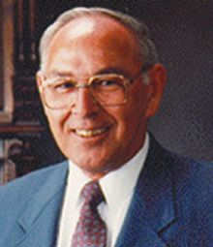
Proto-Germanic Contrastive Features
And second, because all the ingredients of a CHT analysis have already been assembled by Antonsen (1972)!
Elmer Antonsen was an American linguist and runologist who made many contributions to the study of Germanic phonology.
As we have come to expect, his utilization of a contrastive feature hierarchy is only implicit, and not mentioned; however his article is a nice illustration of CHT argumentation avant la lettre.
99

Slide 100
Proto-Germanic Contrastive Features
Antonsen proposes the feature specifications below for the short vowel system (1972: 133):
Notice that they show a pattern of underspecification that is characteristic of a branching tree: the first feature applies to all the phonemes, and the scopes of the remaining features get progressively smaller.
i
u
*/a/
*/u/
*/i/
*/e/
Low
+
–
–
–
e
Rounded
+
–
–
a
High
+
–
100

Slide 101
Proto-Germanic Contrastive Features
Antonsen (1972: 132–133) supports these feature specifications by citing patterns of phonological activity (neutralizations, harmony, and distribution of allophones) and loan word adaptation from Latin.
Thus, based on the evidence from the descendant dialects, he assumes that */a/ had allophones *[a, æ, ə, ɒ], which all have in common that they are [+low].
i
u
*/a/
*/u/
*/i/
*/e/
Low
+
–
–
–
e
Rounded
+
–
–
a
[+low]
High
+
–
101

Slide 102
Proto-Germanic Contrastive Features
Further, there is evidence that */i/ and */u/ had lowered allophones before */a/, again suggesting that */a/ had a [+low] feature that could affect vowel height.
And there is no evidence that */a/ had any other active features (that is, features that played a role in the phonology by affecting neighbouring segments, or that grouped */a/ with other segments as a natural class).
i
u
*/a/
*/u/
*/i/
*/e/
Low
+
–
–
–
e
Rounded
+
–
–
a
[+low]
High
+
–
102

Slide 103
Proto-Germanic Contrastive Features
As the feature that distinguishes */u/ from */i/ and */e/ Antonsen chooses [rounded].
His reason is that all the allophones of */u/ were rounded.
We will return shortly to this specific aspect of the analysis.
i
u
*/a/
*/u/
*/i/
*/e/
[+rounded]
Low
+
–
–
–
e
Rounded
+
–
–
a
[+low]
High
+
–
103

Slide 104
Proto-Germanic Contrastive Features
Antonsen observes that the contrast between */i/ and */e/ was neutralized in environments that affected tongue height (before high front vowels, low vowels, and before nasal clusters).
He argues that this supports distinguishing */i/ and */e/ by one feature, [high].
He notes that the negative specifications of */e/ are consistent with it being “the only vowel which does not cause umlaut assimilations in a preceding root syllable”.
i
[+high]
u
*/a/
*/u/
*/i/
*/e/
[+rounded]
Low
+
–
–
–
e
Rounded
+
–
–
a
[+low]
High
+
–
104

Slide 105
Proto-Germanic Contrastive Features
As elegant as this analysis is, I will follow the majority, including Lass (1994), Ringe (2006: 148), and Purnell & Raimy (2015), in assuming that the feature that distinguishes */i, e/ from */u/ is [front], not [rounded].
The reason is that */i/ could cause allophonic fronting of */u/, which suggests it had an active feature [+front].
i
[+high]
u
*/a/
*/u/
*/i/
*/e/
[+front]
Low
+
–
–
–
e
Front
–
+
+
a
[+low]
High
+
–
105

Slide 106
Proto-Germanic feature hierarchy
With this amendment, the contrastive feature hierarchy for the Proto-Germanic short vowels looks like this.
[low] > [front] > [high]
[+low]
[–low]
*/a/
[+front]
[–front]
All the active features are contrastive, as per the Contrastivist Hypothesis.
[+high]
[–high]
*/u/
*/i/
*/e/
*/a/
*/u/
*/i/
*/e/
Moreover, this analysis explains why certain vowels participate in certain processes and others do not.
Low
+
–
–
–
Front
–
+
+
High
+
–
106

Slide 107
Proto-Germanic feature hierarchy
[low] > [front] > [high]
Notice that the feature [round] plays no role in the contrastive phonology at this point.
[+low]
[–low]
*/a/
[+front]
[–front]
[+high]
[–high]
*/u/
This aspect of the analysis will soon become very significant!
*/i/
*/e/
*/a/
*/u/
*/i/
*/e/
Low
+
–
–
–
Front
–
+
+
High
+
–
107

Slide 108
Monday 26 October 2020
Introduction
Part I
Part II
1. CHT Main Tenets
2. Features in CHT
3. Acquisition: BP
vowel system
4. Synchrony:
PGmc. Vowels
5. Diachrony: West
Gmc. i-Umlaut
Conclusions
Part II: A Theory of Contrast
5. Diachronic Phonology:
West Germanic i-Umlaut
108

Slide 109
Contrast shift and phonological change
Contrastive hierarchies have been fruitfully applied to phonological change in a variety of languages.
Some studies utilizing a version of CHT are listed below.
Diachronic studies using contrastive feature hierarchies include:
Zhang (1996) and Dresher & Zhang (2005) on Manchu; Barrie (2003) on Cantonese; Rohany Rahbar (2008) on Persian; Dresher (2009: 215–225) on East Slavic; Ko (2010, 2011, 2018) on Korean, Mongolic, and Tungusic; Compton & Dresher (2011) on Inuit; Gardner (2012), Roeder & Gardner (2013), and Purnell & Raimy (2013) on North American English vowel shifts; Harvey (2012) on Ob-Ugric (Khanty and Mansi); Oxford (2012, 2015) on Algonquian; Voeltzel (2016), Schalin (2017), and Sandstedt (2018) on Scandinavian; and Krekoski (2017) on Chinese tonal systems.
109

Slide 110
West Germanic i-umlaut
Contrastive Hierarchy Theory can shed new light on a long-standing conundrum in the history of West Germanic.
It concerns the rule of i-umlaut, and illustrates how a post-lexical phonetic rule can become lexical, and how an enhancement feature can become contrastive.
110

Slide 111
The “Oops, I Need That” Problem
It also provides a nice empirical test of what Nevins (2015) calls the “Oops, I Need That” Problem.
This problem refers to a situation where a non-contrastive feature is needed by the phonology.
According to the Contrastivist Hypothesis, this situation should not arise, because only contrastive features should be active.
Thus, the “Oops, I Need That” Problem would indicate an apparent counterexample to the Contrastivist Hypothesis.
111

Slide 112
Proto-Germanic feature hierarchy
Recall that */i/ and */u/ had lowered allophones due to the influence of the [+low] */a/.
[low] > [front] > [high]
[+low]
[–low]
*/a/
[+front]
[–front]
In West Germanic, the lowered allophone of */u/ developed into a new phoneme */o/.
[+high]
[–high]
*/u/
*/i/
*/e/
This new phoneme filled a gap in the system and brought the [–front] branch into symmetry with the [+front] branch.
*/a/
*/u/
*/i/
*/e/
Low
+
–
–
–
Front
–
+
+
High
+
–
112

Slide 113
West Germanic feature hierarchy
Therefore, the new vowel did not require a change to the inherited Proto-Germanic short vowel feature hierarchy.
Note that the feature [round] is still not contrastive at this point.
[low] > [front] > [high]
[+low]
[–low]
*/a/
[+front]
[–front]
[+high]
[–high]
[+high]
[–high]
*/i/
*/e/
*/u/
*/o/
113

Slide 114
West Germanic i-umlaut
The rule of i-umlaut began in early Germanic as a phonetic process that created fronted allophones of the back vowels when */i(ː)/ or */j/ followed (V. Kiparsky 1932; Twaddell 1938; Benediktsson 1967; Antonsen 1972; Penzl 1972).
In the examples below, */u/ and */oː/ are both fronted (to *[y] and *[ø], respectively) before /i/ in the following syllable:
Gloss
‘evil n.s.’
‘foot n.p.’
West Germanic
*ubil
*foːt+i
i-umlaut
*ybil
*føːt+i
114

Slide 115
i-umlaut: Oops, I need that?
i-umlaut crucially preserves the rounded nature of the fronted vowels; but in our analysis of the West Germanic vowel system, [round] is not contrastive.
Uh-oh! Is this an “Oops, I Need That” Problem?
[low] > [front] > [high]
[+low]
[–low]
*/a/
[+front]
[–front]
[+high]
[–high]
[+high]
[–high]
*/i/
*/e/
*/u/
*/o/
115

Slide 116
i-umlaut: I don’t need it, it’s an enhancement feature!
No! For independent reasons, many commentators, beginning with V. Kiparsky (1932) and Twaddell (1938), proposed that i-umlaut began as a late phonetic rule, and was not part of the contrastive phonology.
Therefore, {round} is available as an enhancement feature at the point that */u, o/ are fronted.
*u b i l
*y b i l
[–low]
[–front]
[+high]
{+round}
[–low]
[+front]
[+high]
{–round}
[–low]
[+front]
[+high]
{+round}
[–low]
[+front]
[+high]
{–round}
116

Slide 117
Pre-Old English i-umlaut
Over time, however, there is evidence that i-umlaut became a lexical rule.
Gloss
‘evil n.s.’
‘foot n.p.’
Pre-Old English
*ubil
*foːt+i
i-umlaut
*ybil
*føːt+i
117

Slide 118
i-umlaut becomes opaque
Already in early Old English, the unstressed /i/trigger of i-umlaut was either lowered after a light syllable, as in yfel,
or deleted after a heavy syllable, as in føːt. These changes made i-umlaut opaque on the surface.
In many cases, the i-umlaut trigger became unrecoverable to learners.
Gloss
‘evil n.s.’
‘foot n.p.’
Pre-Old English
*ubil
*foːt+i
i-umlaut
*ybil
*føːt+i
i-lowering/deletion
yfel
føːt
118

Slide 119
i-umlaut becomes opaque
According to standard accounts, this led to the phonologization of [y(:)] and [ø(:)] as new phonemes.
An example is ‘evil’, whose underlying form is restructured from /ufil/ to /yfel/.
Older grammar
Newer grammar
Gloss
‘evil n.s.’
‘evil n.s.’
Underlying
/ufil/
/yfel/
i-umlaut
yfil
—
i-lowering/deletion
yfel
—
Surface
[yfel]
[yfel]
119

Slide 120
Phonologization paradox
Several scholars have pointed out a problem with this account (Liberman 1991; Fertig 1996; Janda 2003; P. Kiparsky 2015).
As long as i-umlaut remains a phonetic process, it is not clear how it could survive the loss of its triggering contexts; why doesn’t /ufel/ surface as *[ufel]?
After loss of i-umlaut trigger
Underlying
/ufel/
The only way for i-umlaut to persist is if it enters the lexical phonology while [y(:)] and [ø(:)] are still predictable allophones of /u(:)/ and /o(:)/, respectively.
Postlexical Phonology
i-umlaut
—
i-lowering
—
Surface
*[ufel]
120

Slide 121
Phonologization paradox
This account raises two questions:
First, why does i-umlaut enter the lexical phonology while its products are not contrastive?
P. Kiparsky (2015) suggests that it is because the new front rounded allophones were perceptually more salient than their triggers (cf. Jakobson, Fant, & Halle 1952), which were becoming progressively weaker as time when on.
121

Slide 122
Phonologization paradox
I find this explanation to be quite compelling; but it raises another question:
How do the products of i-umlaut enter the lexical phonology when they involve non-contrastive features that originate in enhancement?
To this question Contrastive Hierarchy Theory can contribute an old/new solution based on the notion of contrast shift.
122

Slide 123
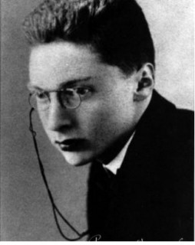
Contrast and phonological change
“Once a phonological change has taken place, the following questions must be asked:
What exactly has been modified within the phonological system?
…has the structure of individual oppositions [contrasts] been transformed? Or in other words, has the place of a specific opposition been changed…?”
Old, because in an article first published in 1931, Roman Jakobson proposed that diachronic phonology must look at contrast shifts (Jakobson 1962 [1931]).
123

Slide 124
Salience and contrast shift
But also new, because that program was never carried out; CHT gives us a well-defined way to look at contrast shifts.
Let us revisit the stage when i-umlaut was still a post-enhancement rule.
Adapting Kiparsky’s idea, I propose that the perceptual salience of the front rounded allophones caused learners to hypothesize that {round} is a contrastive feature.
*u b i l
*y b i l
[–low]
[–front]
[+high]
{+round}
[–low]
[+front]
[+high]
{–round}
[–low]
[+front]
[+high]
{+round}
[–low]
[+front]
[+high]
{–round}
124

Slide 125
Contrast shift in West Germanic
It was not part of the earlier West Germanic feature hierarchy.
But we can construct another contrastive hierarchy that includes [round].
One such hierarchy is shown below.
Earlier hierarchy:
[low] > [front] > [high]
Later hierarchy:
[front] > [round] > [high]
125

Slide 126
Contrast shift in West Germanic
This new hierarchy, however, requires demoting [low] to make room for [round].
This is how contrastive hierarchies work: one can introduce or promote a feature, but there is a trade-off: another feature has to be demoted.
Hopefully not a feature that we need!
Earlier hierarchy:
[low] > [front] > [high]
Later hierarchy:
[front] > [round] > [high]
126

Slide 127
West Germanic feature hierarchy 2
In the new feature hierarchy, the vowels are first divided into [+front] /i, e/ and [–front] /u, o, a/.
[front] > [round] > [high]
[+front]
[–front]
Then [±round] divides /u, o/ from /a/.
[+high]
[–high]
[+round]
[–round]
Finally, [±high] completes the contrastive features.
/i/
/e/
[+high]
[–high]
/a/
/u/
/o/
127

Slide 128
West Germanic feature hierarchy 2
Now, when i-umlaut changes the [–front, +round] vowels /u, o/ to [+front], the result is new front rounded vowels, which begin as allophones.
[y, ø]
/u, o/
[+front]
[+round]
[α high]
[–front]
[+round]
[α high]
128

Slide 129
West Germanic feature hierarchy 2
Here is what the derived tree looks like. The new front rounded vowels [y, ø] are not underlying, but are allophones of /u, o/.
[+front]
[–front]
[+round]
[–round]
[+round]
[–round]
[y, ø]
/u, o/
[+high]
[–high]
[+high]
[–high]
[+high]
[–high]
/a/
[+front]
[+round]
[α high]
[–front]
[+round]
[α high]
[y]
[ø]
/i/
/e/
/u/
/o/
129

Slide 130
West Germanic feature hierarchy 2
Although they are allophones, they can arise in the contrastive phonology because they consist only of contrastive features.
[+front]
[–front]
[+round]
[–round]
[+round]
[–round]
[y, ø]
/u, o/
[+high]
[–high]
[+high]
[–high]
[+high]
[–high]
/a/
[+front]
[+round]
[α high]
[–front]
[+round]
[α high]
[y]
[ø]
/i/
/e/
/u/
/o/
130

Slide 131
Deep allophones
They are thus what Moulton (2003) calls ‘deep allophones’; he was referring to the Old English voiced fricatives, which also arise early in the contrastive (lexical) phonology as allophones of the voiceless fricatives.
Deep allophones are possible because contrastive features can be predictable in a hierarchical approach.
We have left hanging one question that you might be wondering about…
131

Slide 132
West Germanic feature hierarchy 2: Oops, I need that?
Recall the trade-off that this analysis requires:
[front] > [round] > [high]
In the new hierarchy, /a/ no longer has a [+low] feature.
[+front]
[–front]
[+high]
[–high]
[+round]
[–round]
Uh oh! Do we now have a “Oops, I Need That” Problem?
/i/
/e/
[+high]
[–high]
/a/
/u/
/o/
132

Slide 133
West Germanic feature hierarchy 2: No, I don’t need it!
No! /a/ no longer needs a [+low] feature!
I know of no evidence— in Old English, for example—that /a/ causes lowering of other segments, or other-wise needs an active [+low] feature.
[–front]
[+round]
[–round]
[+high]
[–high]
/a/
/u/
/o/
133

Slide 134
West Germanic feature hierarchy 2: No, I don’t need it!
Recall that this is in striking contrast to earlier stages of the language, where there is evidence that */a/ caused lowering.
[+low]
[–front]
This type of connection between contrast and activity is exactly what Contrastive Hierarchy Theory predicts.
*/a/
[–round]
/a/
Hierarchy 1
Hierarchy 2
134

Slide 135
Monday 26 October 2020
Introduction
Part I:
Historical Antecedents
Part II:
A Theory of Contrast
Conclusion
Conclusion
135

Slide 136
Conclusions
To sum up, Contrastive Hierarchy Theory makes testable empirical predictions about phonological systems, provides interesting accounts of acquisition, and a new way of looking at phonological inventories.
Of course, many questions remain to be explored:
Can the Contrastivist Hypothesis be sustained or does the “Oops, I Need That” Problem (i.e. too much activity) arise?
Conversely, what happens when there is too little activity? Does phonetics play a larger role in determining the features (cf. Krekoski 2017)?
Are there constraints, apart from contrast, on what phonological features can be?
136

Slide 137
Conclusions
How stable are contrastive hierarchies across time and space?
How do learners acquire the feature hierarchy of their language?
I have tried to show that the ideas that Contrastive Hierarchy Theory are built on have a long and even distinguished pedigree in the history of phonology.
For various reasons, this theory never quite came together in the 20th century.
It is my hope that the full potential of this approach will be realized in the 21st.
137

Slide 138
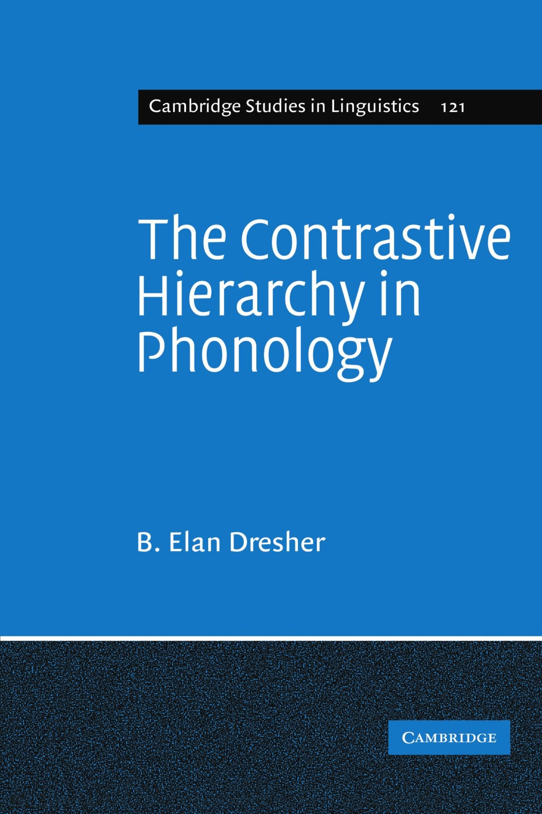
For discussions and ideas I would like to thank Graziela Bohn, Elizabeth Cowper, Daniel Currie Hall, Paula Fikkert, Ross Godfrey, Christopher Harvey, Norbert Hornstein, Harry van der Hulst, Bill Idsardi, Ross Krekoski, David Lightfoot, Sara Mackenzie, Andrew Nevins, Will Oxford, Keren Rice, Christopher Spahr, and Zhang Xi.
And thank you!
Muito obrigado!
For more recent papers and talks, please see:
https://dresher.artsci.utoronto.ca
138

Slide 139
References
Antonsen, Elmer H. 1972. The Proto-Germanic syllabics (vowels). In Frans van Coetsem & Herbert L. Kufner (eds.), Toward a grammar of Proto-Germanic, 117–140. Tübingen: MaNiemeyer.
Archangeli, Diana. 1988. Underspecification in phonology. Phonology 5(2): 183–207.
Barbosa, Plínio A. & Eleonora Cavalcante Albano. 2004. Brazilian Portuguese. Journal of the International Phonetics Association 34: 227–32.
Barrie, Mike. 2003. Contrast in Cantonese vowels. Toronto Working Papers in Linguistics 20: 1–19.
Benediktsson, Hreinn. 1967. The Proto-Germanic vowel system. In To honor Roman Jakobson, Vol. 1, 174–96. The Hague & Paris: Mouton.
Bohn, Graziela Pigatto. 2015. Aquisição das vogais tônicas e pretônicas do Português Brasileiro. Doctoral dissertation, University of São Paulo.
Bohn, Graziela Pigatto. 2017. The acquisition of tonic and pre-tonic vowels in Brazilian Portuguese. Journal of Portuguese Linguistics 16(7), 1–5. DOI: https://doi.org/10.5334/jpl.184
Bohn, Graziela Pigatto & Raquel Santana Santos. 2018. The acquisition of pre-tonic vowels in Brazilian Portuguese. Alfa: Revista de Linguística (São José do Rio Preto) 62(1): 191–221.
Calabrese, Andrea. 2005. Markedness and economy in a derivational model of phonology. Berlin: Mouton de Gruyter.
139

Slide 140
Campos Astorkiza, Judit Rebeka. 2009. Minimal contrast and the phonology – phonetics interaction. Munich: Lincom Europa.
Carvalho, Joaquim Brandão de. 2011. Contrastive hierarchies, privative features, and Portuguese vowels. Linguistica. Revista de estudos linguisticos da universidade do Porto 6: 51–66.
Chomsky, Noam & Morris Halle. 1968. The sound pattern of English. New York, NY: Harper & Row.
Clements, G. N. 2001. Representational economy in constraint-based phonology. In T. Alan Hall, (ed.), Distinctive feature theory, 71–146. Berlin: Mouton de Gruyter.
Clements, G. N. 2003. Feature economy in sound systems. Phonology 20: 287–333.
Clements, G. N. 2009. The role of features in speech sound inventories. In Eric Raimy & Charles E. Cairns (eds.), Contemporary views on architecture and representations in phonological theory, 19–68. Cambridge, MA: MIT Press.
Compton, Richard & B. Elan Dresher. 2011. Palatalization and ‘strong i’ across Inuit dialects. Canadian Journal of Linguistics/ Revue canadienne de linguistique 56: 203–28.
Dinnsen, Daniel A. 1992. Variation in developing and fully developed phonetic inventories. In Charles A. Ferguson, Lisa Menn, & Carol Stoel-Gammon (eds.), Phonological development: Models, research, implications, 191–210. Timonium, MD: York Press.
Dinnsen, Daniel A. 1996. Context-sensitive underspecification and the acquisition of phonetic contrasts. Journal of Child Language 23: 31–55.
140

Slide 141
Dinnsen, Daniel A., Steven B. Chin, Mary Elbert, & Thomas W. Powell. 1990. Some constraints on functionally disordered phonologies: Phonetic inventories and phonotactics. Journal of Speech and Hearing Research 33: 28–37.
Dresher, B. Elan. 1998a. Child phonology, learnability, and phonological theory. In Tej Bhatia & William C. Ritchie (eds.), Handbook of language acquisition, 299–346. New York: Academic Press.
Dresher, B. Elan. 1998b. On contrast and redundancy. Presented at the annual meeting of the Canadian Linguistic Association, Ottawa. Ms., University of Toronto.
Dresher, B. Elan. 2003. Contrast and asymmetries in inventories. In Anna-Maria di Sciullo (ed.), Asymmetry in grammar, volume 2: Morphology, phonology, acquisition, 239–57. Amsterdam: John Benjamins.
Dresher, B. Elan. 2009. The contrastive hierarchy in phonology. Cambridge: CUP.
Dresher, B. Elan. 2016. Contrast in phonology 1867–1967: History and development. Annual Review of Linguistics 2: 53–73.
Dresher, B. Elan. 2018. Contrastive Feature Hierarchies in Old English Diachronic Phonology. Transactions of the Philological Society 116(1): 1–29.
Dresher, B. Elan & Daniel Currie Hall. To appear. The road not taken: SPR and the history of contrast in phonology. To appear in Journal of Linguistics (CUP).
Dresher, B. Elan & Harry van der Hulst. To appear. Leading ideas in phonology. In B. Elan Dresher & Harry van der Hulst (eds.), The Oxford handbook of the history of phonology. Oxford: OUP.
141

Slide 142
Dresher, B. Elan, Glyne L. Piggott, & Keren Rice. 1994. Contrast in phonology: Overview. Toronto Working Papers in Linguistics 13.1. iii-xvii.
Dresher, B. Elan & Keren Rice. 2007. Markedness and the contrastive hierarchy in phonology. https://dresher. artsci.utoronto.ca/contrast/
Dresher, B. Elan & Xi Zhang. 2005. Contrast and phonological activity in Manchu vowel systems. Canadian Journal of Linguistics/Revue canadienne de linguistique 50: 45–82.
Dyck, Carrie. 1995. Constraining the phonology–phonetics interface, with exemplification from Spanish and Italian dialects. Doctoral dissertation, University of Toronto.
Fertig, David. 1996. Phonology, orthography, and the umlaut puzzle. In Rosina L. Lippi-Green & Joseph C. Salmons (eds.), Germanic linguistics: Syntactic and diachronic, 169–184. Amsterdam/Philadelphia: John Benjamins.
Fikkert, Paula. 1994. On the acquisition of prosodic structure (HIL Dissertations 6). Dordrecht: ICG Printing.
Gardner, Matt Hunt. 2012. Beyond the phonological void: Contrast and the Canadian Shift. Ms., Department of Linguistics, University of Toronto.
Hall, Daniel Currie. 2007. The role and representation of contrast in phonological theory. Doctoral dissertation, University of Toronto.
Hall, Daniel Currie. 2011. Phonological contrast and its phonetic enhancement: Dispersedness without dispersion. Phonology 28: 1–54.
142

Slide 143
Halle, Morris. 1959. The sound pattern of Russian: A linguistic and acoustical investigation. The Hague: Mouton. Second printing, 1971.
Harvey, Christopher. 2012. Contrastive shift in Ob-Ugric Vowel systems. Ms., Department of Linguistics, University of Toronto.
Hirayama, Manami. 2003. Contrast in Japanese vowels. Toronto Working Papers in Linguistics 20: 115–32. Ingram, David. 1988. Jakobson revisited: Some evidence from the acquisition of Polish phonology. Lingua 75: 55–82.
Ingram, David. 1989. First language acquisition: Method, description and explanation. Cambridge: CUP.
Jakobson, Roman. 1941. Kindersprache, Aphasie, und allgemeine Lautgesetze. Uppsala: Uppsala Universitets Arsskrift.
Jakobson, Roman. 1962 [1931]. Phonemic notes on Standard Slovak. In Selected writings I. Phonological studies, 221–30. The Hague: Mouton. [In Czech in Slovenská miscellanea (Studies presented to Albert Pražak). Bratislava, 1931.]
Jakobson, Roman. 1968. Child language, aphasia, and phonological universals. Translation by A. R. Keiler of Jakobson 1941. The Hague: Mouton.
Jakobson, Roman. 1974. Lenguaje infantil y afasia. Translation by Esther Benítez of Jakobson 1941. Madrid: Ayuso.
Jakobson, Roman, C. Gunnar M. Fant, & Morris Halle. 1952. Preliminaries to speech analysis. MIT Acoustics Laboratory, Technical Report, No. 13. Reissued by MIT Press, Cambridge, Mass., Eleventh Printing, 1976.
143

Slide 144
Jakobson, Roman & Morris Halle. 1956. Fundamentals of language. The Hague: Mouton.
Janda, Richard D. 2003. “Phonologization” as the start of dephoneticization – or, on sound change and its aftermath: Of extension, generalization, lexicalization, and morphologization. In Brian D. Joseph & Richard D. Janda, (eds.), The handbook of historical linguistics, 401–422. Oxford: Blackwell.
Jones, Daniel. 1967. The phoneme: Its nature and use, 3rd edition (with an Appendion the history and meaning of the term “phoneme”). Cambridge: Cambridge University Press.
Keyser, Samuel Jay & Kenneth N. Stevens. 2001. Enhancement revisited. In Michael J. Kenstowicz (ed.), Ken Hale: A life in language, 271–91. Cambridge, Mass.: MIT Press.
Keyser, Samuel Jay & Kenneth N. Stevens. 2006. Enhancement and overlap in the speech chain. Language 82: 33–63.
Kiparsky, Paul. 2015. Phonologization. In Patrick Honeybone & Joseph Salmons (eds.), The handbook of historical phonology, 563–79. Oxford: Oxford University Press.
Kiparsky, Valentin. 1932. Johdatusta fonologiaan. Virittäjä 36: 230–50.
Ko, Seongyeon. 2010. A contrastivist view on the evolution of the Korean vowel system. Proceedings of the Sixth Workshop on Altaic Formal Linguistics (WAFL 6). MIT Working Papers in Linguistics 61: 181–96.
Ko, Seongyeon. 2011. Vowel contrast and vowel harmony shift in the Mongolic languages. Proceedings of the Seventh Workshop on Altaic Formal Linguistics (WAFL 7). MIT Working Papers in Linguistics 62: 187–202.
Ko, Seongyeon. 2018. Tongue root harmony and vowel contrast in Northeast Asian languages. Wiesbaden: Harrassowitz Verlag.
144

Slide 145
Krekoski, Ross. 2017. Contrast and complexity in Chinese tonal systems. Doctoral dissertation, University of Toronto.
Lass, Roger. 1994. Old English: A historical linguistic companion. Cambridge: Cambridge University Press.
Levelt, Clara C. 1989. An essay on child phonology. M.A. thesis, Leiden University.
Liberman, Anatoly. 1991. Phonologization in Germanic: Umlauts and vowel shifts. In Elmer H. Antonsen & Hans Henrich Hock (eds.), Stæfcræft: Studies in Germanic linguistics, 125–37. Amsterdam: John Benjamins.
Lightner, Theodore McGraw. 1963. A note on the formation of phonological rules. Quarterly progress report (Research Laboratory of Electronics, MIT) 68: 187–9.
Mackenzie, Sara. 2009. Contrast and similarity in consonant harmony processes: Doctoral dissertation, University of Toronto.
Mielke, Jeff. 2008. The emergence of distinctive features. Oxford: OUP.
Moulton, Keir. 2003. Deep allophones in the Old English laryngeal system. Toronto Working Papers in Linguistics 20: 157–73.
Nevins, Andrew. 2010. Locality in vowel harmony. Cambridge, MA: MIT Press.
Nevins, Andrew. 2012. Vowel lenition and fortition in Brazilian Portuguese. Letras de Hoje 47(3): 228–33.
Nevins, Andrew. 2015. Triumphs and limits of the contrastivity-only hypothesis. Linguistic Variation 15(1): 41–68.
Oxford, Will. 2012. ‘Contrast shift’ in the Algonquian languages. Proceedings from the Montreal-Ottawa-Toronto (MOT) Phonology Workshop 2011: Phonology in the 21st Century: In Honour of Glyne Piggott. McGill Working Papers in Linguistics 22(1). 9 pages. http://www.mcgill.ca/mcgwpl/files/mcgwpl/oxford2012_0.pdf.
145

Slide 146
Oxford, Will. 2015. Patterns of contrast in phonological change: Evidence from Algonquian vowel systems. Language 91: 308–57.
Padgett, Jaye. 2003. Contrast and post-velar fronting in Russian. Natural Language and Linguistic Theory 21: 39–87.
Penzl, Herbert. 1972. Methods of comparative Germanic linguistics. In Frans van Coetsem & Herbert L. Kufner (eds.), Toward a grammar of Proto-Germanic, 1–43. Tübingen: MaNiemeyer.
Purnell, Thomas & Eric Raimy. 2013. Contrastive features in phonetic implementation: The English vowel system. Presented at the CUNY Phonology Forum Conference On The Feature, January 2013.
Purnell, Thomas & Eric Raimy. 2015. Distinctive features, levels of representation and historical phonology. In Patrick Honeybone & Joseph Salmons (eds.), The handbook of historical phonology, 522–44. Oxford: Oxford University Press.
Pye, Clifton, David Ingram, & Helen List. 1987. A comparison of initial consonant acquisition in English and Quiché. In Keith E. Nelson & Ann Van Kleeck (eds.), Children's language (vol. 6), 175–90. Hillsdale, NJ: Erlbaum.
Rice, Keren. 2003. Featural markedness in phonology: Variation. In Lisa Cheng & Rint Sybesma (eds.), The second Glot International state-of-the-article book: The latest in linguistics, 387–427. Berlin: Mouton de Gruyter.
Rice, Keren. 2007. Markedness in phonology. In Paul de Lacy (ed.), The Cambridge handbook of phonology, 79–97. Cambridge: CUP.
146

Slide 147
Ringe, Donald. 2006. A history of English: From Proto-Indo-European to Proto-Germanic (A linguistic history of English, Vol. 1). Oxford: Oxford University Press. Oxford Scholarship Online (www.oxfordscholarship.com).
Roeder, Rebecca V. & Matt Hunt Gardner. 2013. The phonology of the Canadian Shift revisited: Thunder Bay and Cape Breton. University of Pennsylvania Working Papers in Linguistics (Selected Papers from NWAV 41) 19.2: 161–70.
Rohany Rahbar, Elham. 2008. A historical study of the Persian vowel system. Kansas Working Papers in Linguistics 30: 233–45.
Samuels, Bridget D. 2011. Phonological architecture : A biolinguistic perspective. Oxford: OUP.
Sandstedt, Jade. 2018. Feature specifications and contrast in vowel harmony: The orthography and phonology of Old Norwegian height harmony. Doctoral dissertation, University of Edinburgh.
Sapir, Edward. 1925. Sound patterns in language. Language 1: 37–51.
Schalin, Johan. 2017. Scandinavian umlaut and contrastive feature hierarchies. NOWELE 70(2): 171–254.
Spahr, Christopher. 2012. Positional neutralization in the Contrastive Hierarchy: The case of phonological vowel reduction. Ms., University of Toronto. Available at http://individual.utoronto.ca/spahr/.
Spahr, Christopher. 2014. A contrastive hierarchical account of positional neutralization. The Linguistic Review 31(3–4): 551–85.
Stanley, Richard. 1967. Redundancy rules in phonology. Language 43: 393–436.
Stevens, Kenneth N. & Samuel Jay Keyser. 1989. Primary features and their enhancement in consonants. Language 65: 81–106.
147

Slide 148
Stevens, Kenneth N., Samuel Jay Keyser & Haruko Kawasaki. 1986. Toward a phonetic and phonological theory of redundant features. In Joseph S. Perkell & Dennis H. Klatt (eds.), Symposium on invariance and variability of speech processes, 432–69. Hillsdale, NJ: Lawrence Erlbaum.
Sweet, Henry. 1877. A handbook of phonetics. Oxford: Clarendon Press.
Trubetzkoy, N. S. 1939. Grundzüge der Phonologie. Göttingen: Vandenhoek & Ruprecht.
Trubetzkoy, N. S. 1969. Principles of phonology. Translation by Christiane A. M. Baltaxe of Trubetzkoy 1939. Berkeley: University of California Press.
Trubetzkoy, N. S. 2001 [1936]. A theory of phonological oppositions. In Anatoly Liberman (ed.), Studies in general linguistics and language structure, 14–21. Translated by Marvin Taylor & Anatoly Liberman. Durham, NC: Duke University Press. [Essai d’une théorie des oppositions phonologiques. Journal de psychologie normale et pathologique 33 (1936), 5–18.]
Trubetzkoy, N. S. 2019. Principios de fonología. Nueva traducción y versión crítica de Esther Herrera Zendeyas y Michael Herbert Knapp. Mexico City: El Colegio de México, Centro de Estudios Lingüísticos y Literarios.
Twaddell, W. Freeman. 1938. A note on OHG umlaut. Monatshefte für deutschen Unterricht 30: 177–181.
Voeltzel, Laurence. 2016. Morphophonologie des langues scandinaves: Hiérarchie segmentale et complexité syllabique. Doctoral dissertation, University of Nantes.
Zhang, Xi. 1996. Vowel systems of the Manchu-Tungus languages of China. Doctoral dissertation, University of Toronto.
148

Slide 149
